Slide 1
Criminal Data Management System
ADVANCED PROGRAMMING PRACTICES PROJECT

Slide 2
HOW WILL IT BE DEPICTED ?
There are 3 categories that a user can file:
Complaint
Crime Report
Status of the suspect

Slide 3
PROGRAMMING LANGUAGE AND SOFTWARE
PYTHON
SQLITE

Slide 4
GUI
We have used the tkinter module to provide a graphical user interface for our project
It is one of the most commonly used modules for creating GUI applications in Python as it is simple and easy to work with.
It gives an object-oriented interface to the Tk GUI toolkit.

Slide 5
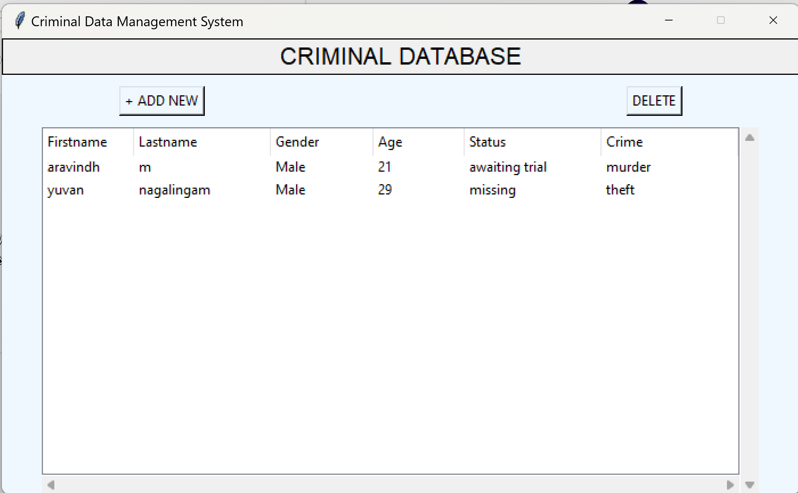
CURRENT INTERFACE WINDOW

Slide 6
DATABASE
We plan on storing all the data input from the python interface into a sqlite database in a tabulated format
This ensures in easy traversal of data and easy management
We plan to make this possible by the use of the mysqlconnector module.

Slide 7
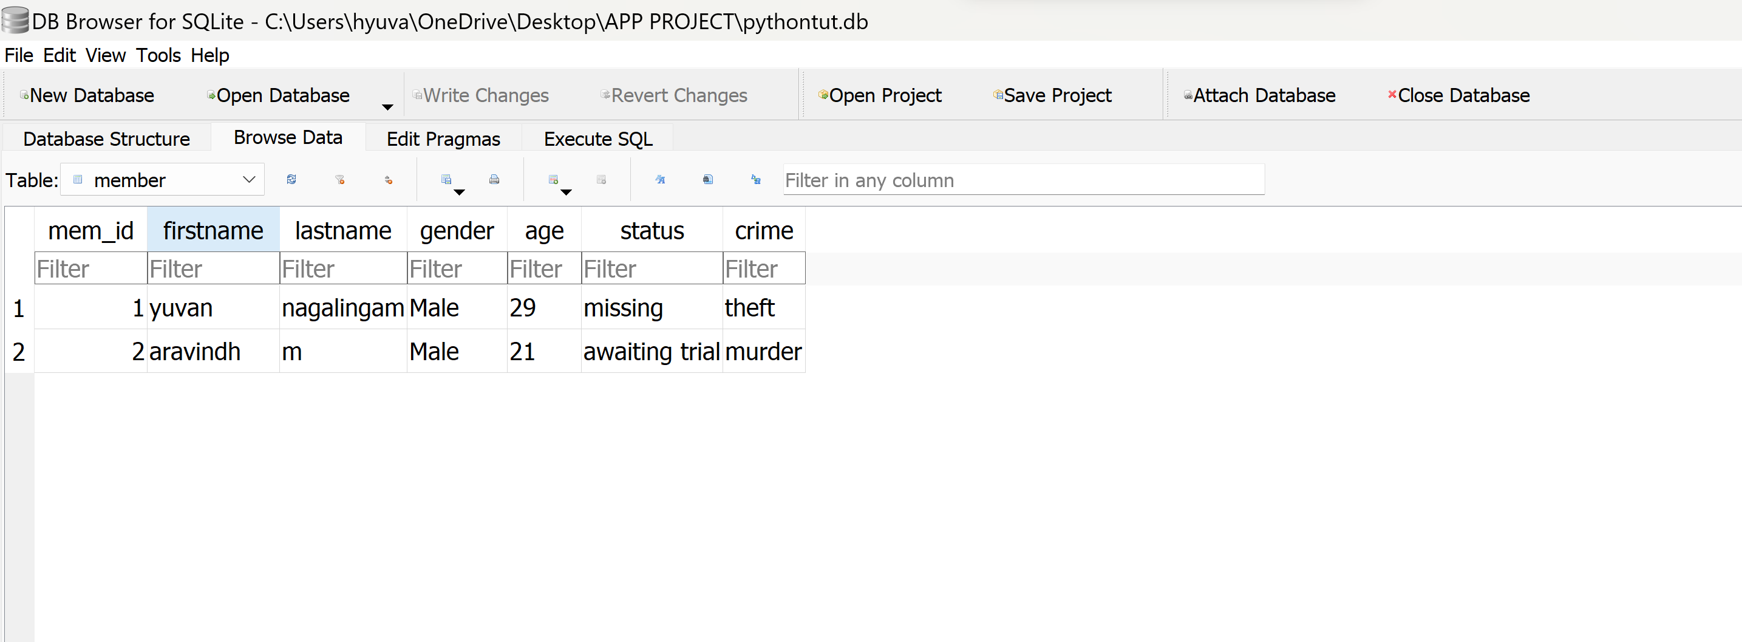
DATABASE WINDOW

